Slide 1
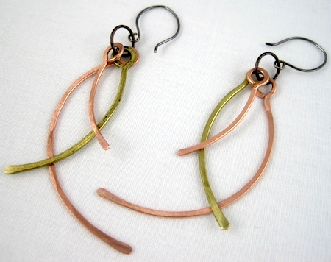
Wire Earrings

Slide 2
Project description
Students will create a set of wire earrings. They will learn and use forming techniques of bending, hammering, twisting, wrapping, piercing, and texturing to create a unified composition that shows movement. Each piece will need to use at least 4 out of the 6 techniques that will be demonstrated in class. Earrings need to be a set that are identical on both sides. Students need to think about function, weight, and comfort.

Slide 3
Requirements
Projects must:
Use 4 of the 6 techniques show in class
Show movement
Be identical on both sides
Function properly

Slide 4
Elements and Principles to Focus on
Elements
Principles
Line-is a mark with greater length than width. Lines can be horizontal, vertical, or diagonal; straight or curved; thick or thin.
Each type of line can have meaning.
Diagonal lines show movement
Horizonal shows stability
Vertical demonstrates height and grandeur
Movement-Shows action, or alternatively, the path the viewers eye follows through the peice.
Unity-All elements of the piece work together harmoniously to create a well thought our composition.

Slide 5
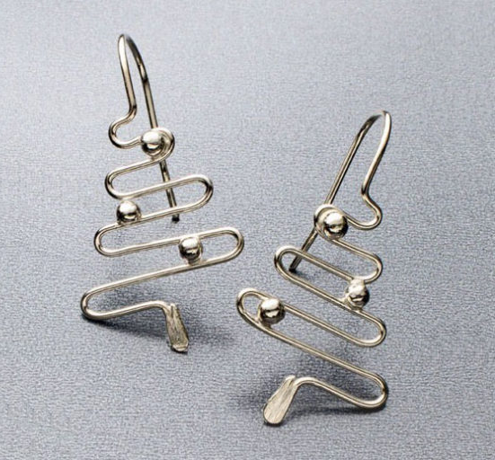
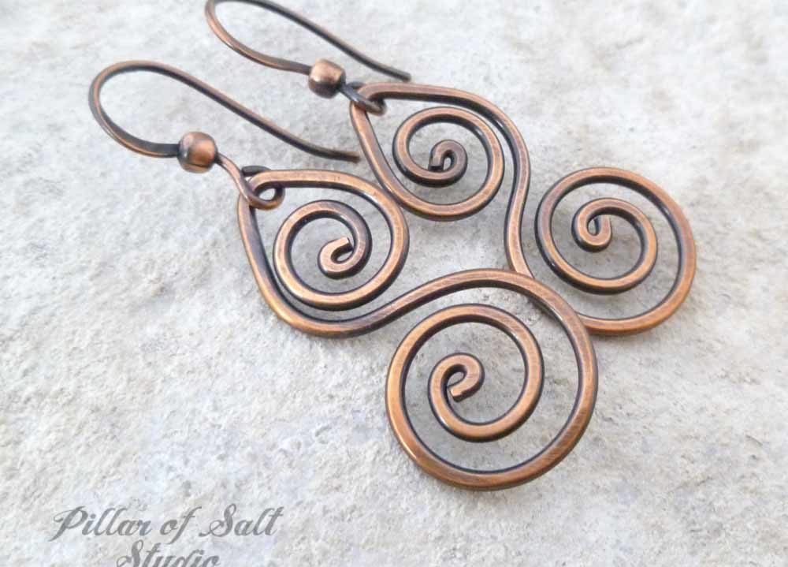
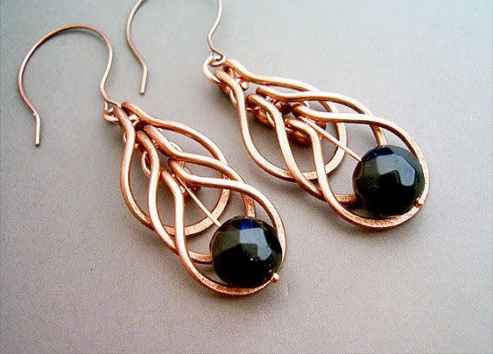

Slide 6
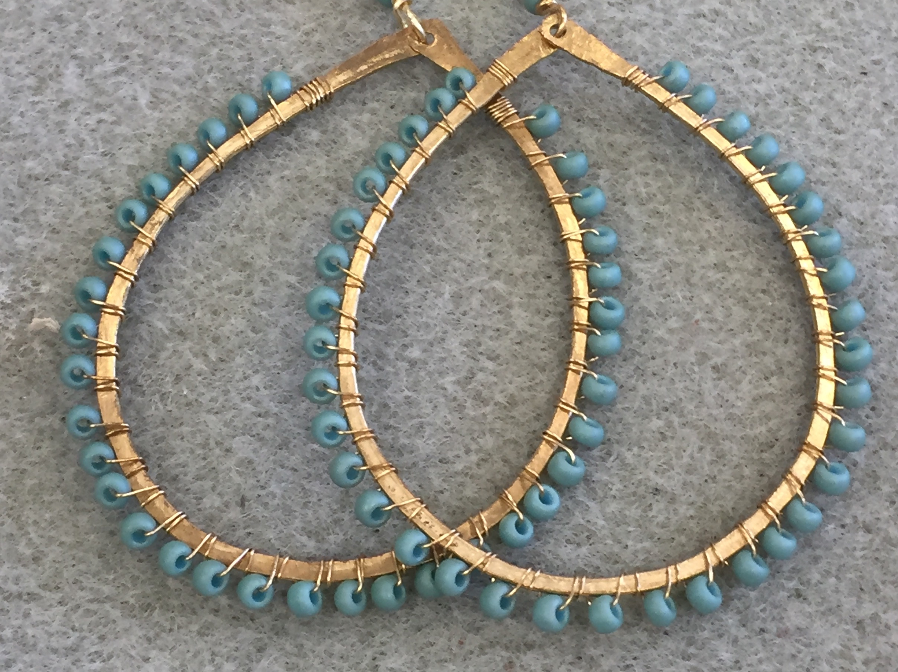
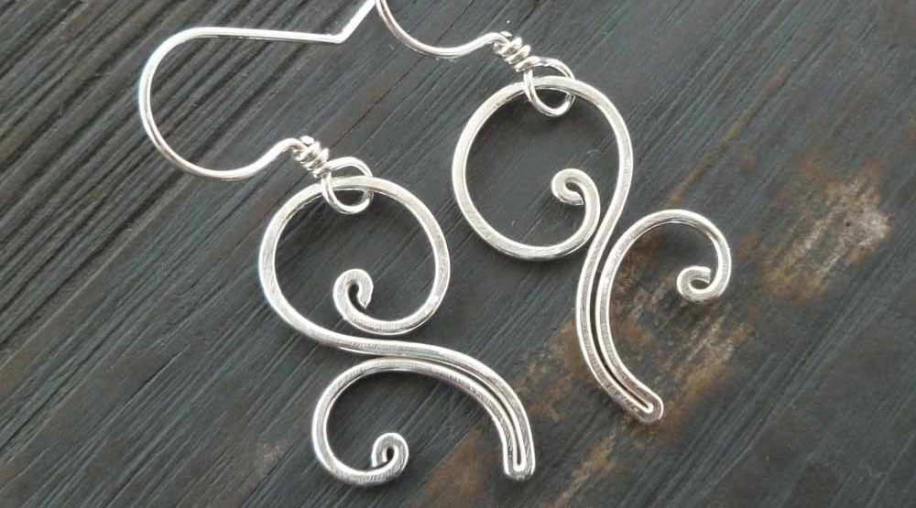
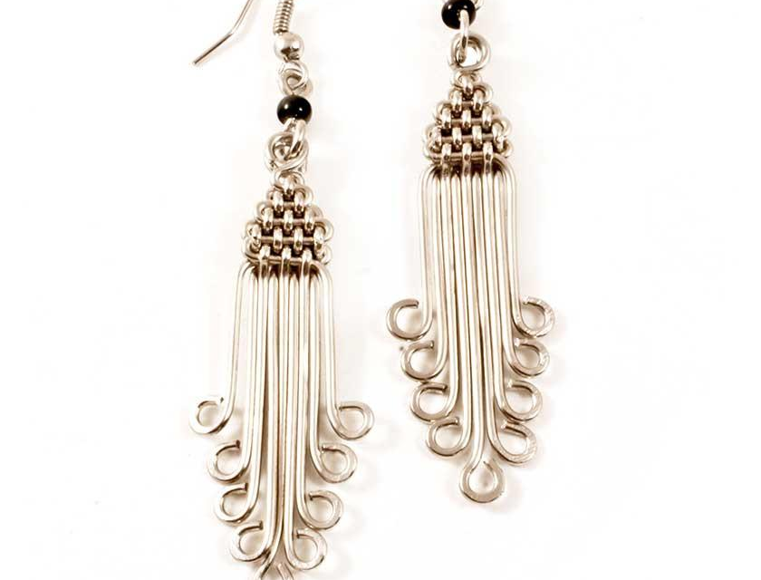

Slide 7
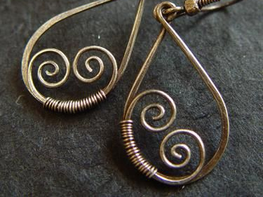
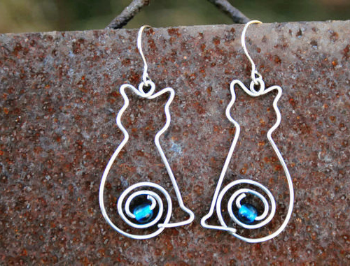

Slide 8
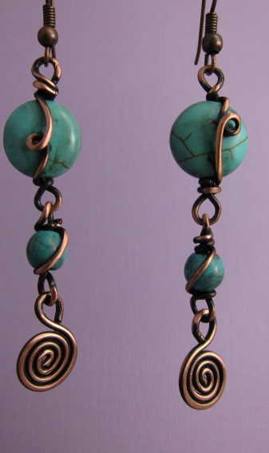
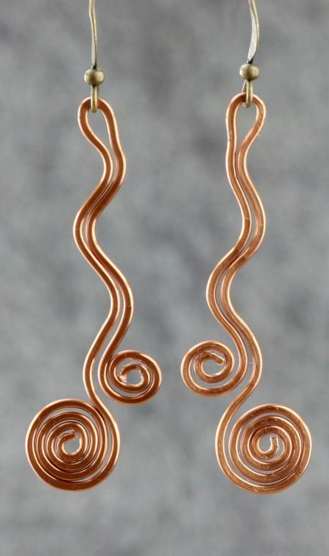
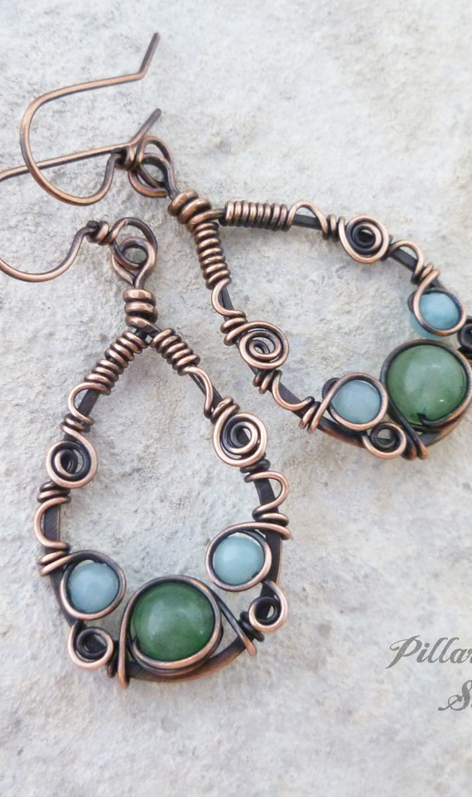

Slide 9
Sketchbook Assignment
You need to create three separate sketches of three different ideas
Sketches need to be in color, drawn to full scale of the complete piece, and drawn with intent
Once sketches are drawn you need to pair up with your everyone at your table (4 per group) and discuss your sketches to get feed back on how well you used line, movement, and unity.
Your partners need to discuss what is your best idea and why and give one way you could improve or better your design.

