Slide 1
Lines

Slide 2
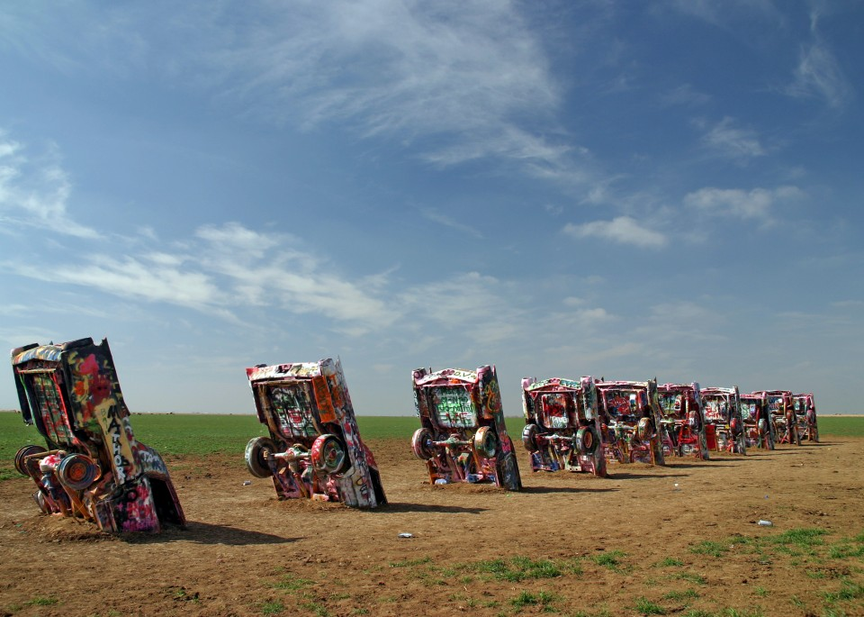
Line-is one of the most versatile elements in art. In three-dimensional design, we can create line through the following:
A series of adjacent points.
The cars that make up Cadillac Ranch are distinct objects in themselves as well as the points that create a line of cars.
Commissioned by a rancher in Texas, some have described this as a requiem for the gas-guzzling American automobile
Ant Farm (Chip Lord, Hudson Marquez, Doug Michels), Cadillac Ranch. 1974

Slide 3
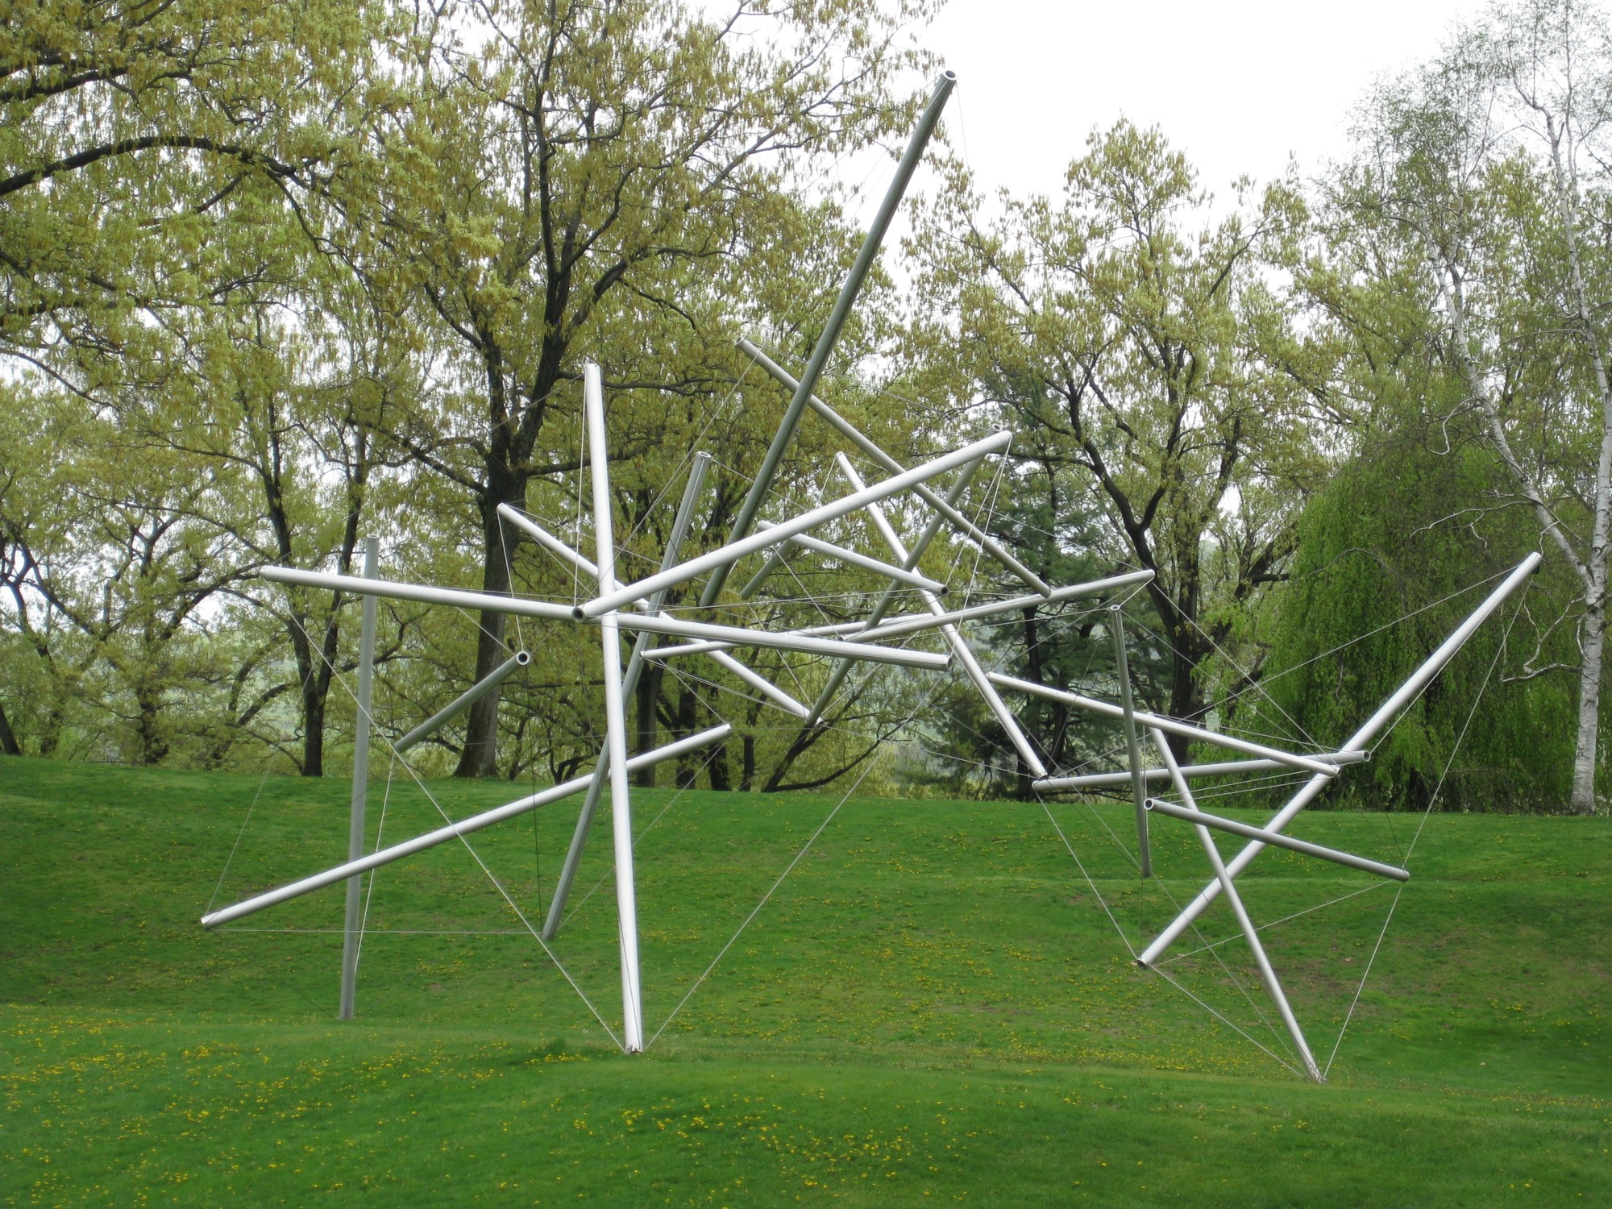
Line…Continued
Connection between points.
Kenneth Snelson constructed Free Ride Home using two types of line.
The aluminum tubes provide a linear skeleton that becomes elevated when the connecting lines are attached.
The resulting diagonal lines seem to defy gravity.
Kenneth Snelson, Free Ride Home, 1974

Slide 4
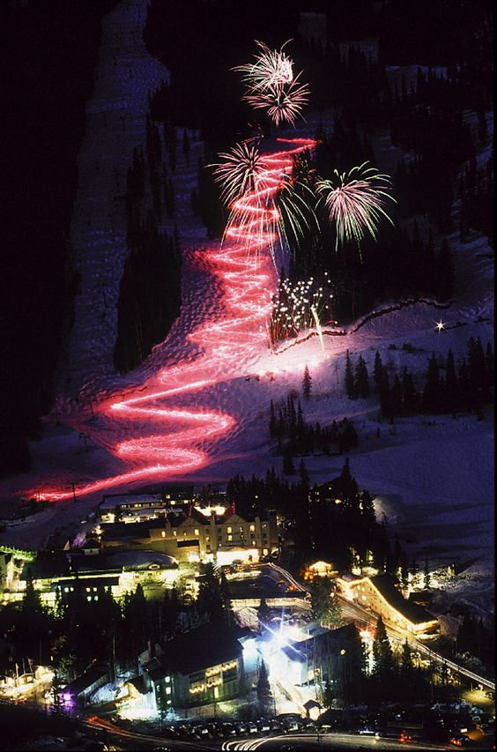
Lines…Continued
A point in Motion.
In combination with New Years Eve fireworks, Skiers in Toas, New Mexico, zoom down major slopes carrying flashlights.
This image shows that they create lines of light from each moving point.

Slide 5
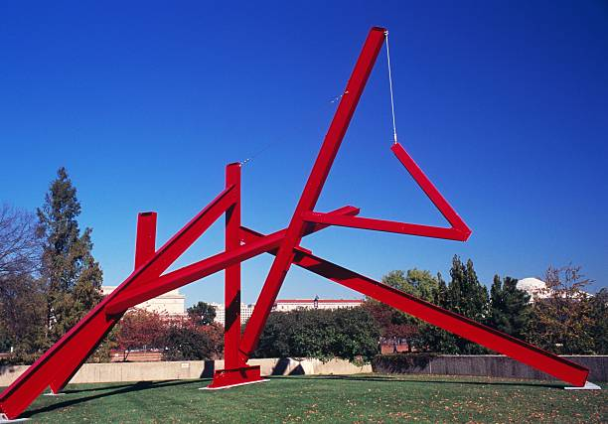
Line Quality-Each line has its own distinctive quality. Orientation, direction, continuity and material all contribute to this distinctive quality.
Orientation
This refers to the lines horizontal, vertical, or diagonal position.
We associate horizontal with stability
Diagonal with movement
Vertical lines accentuate height and can make an object appear grand.
Mark di Suvero. Are Years What?, 1967

Slide 6
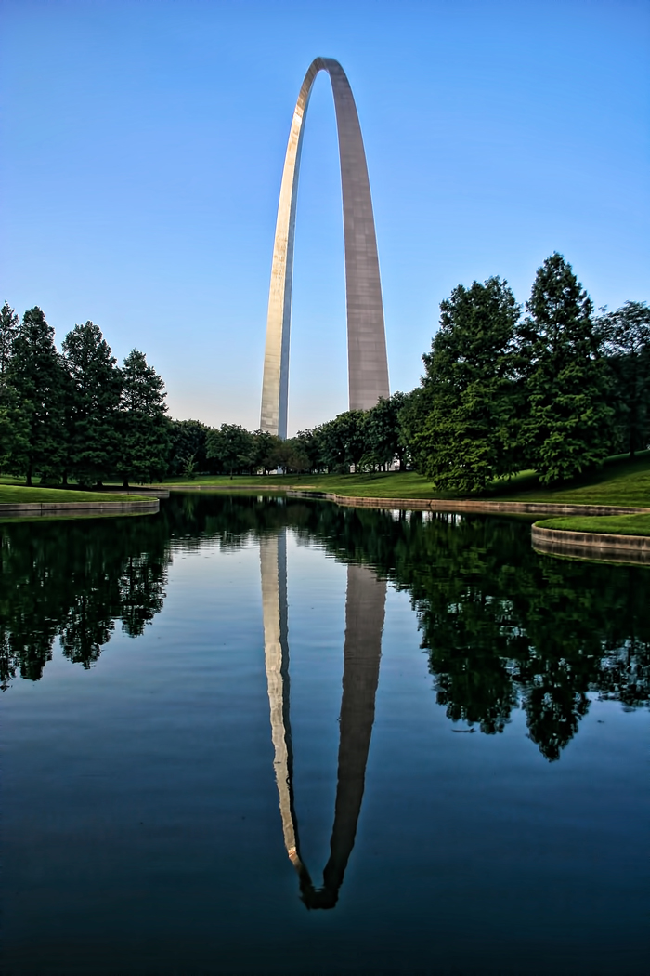
Line Quality…Continued
Direction
Refers to the implied movement of a line.
A line of consistent width tends to suggest equal movement in both directions
Varying line widths can create a more specific direction of movement.
In Jefferson National Expansion Memorial, the massive lines at the bottom drive downward into the earth, while the tapered arch at the top lifts our eyes skyward
Eero Saarinen and Hannskarl Bandel, Jefferson National Expansion
Memorial (Gateway Ach). 1963-65

Slide 7
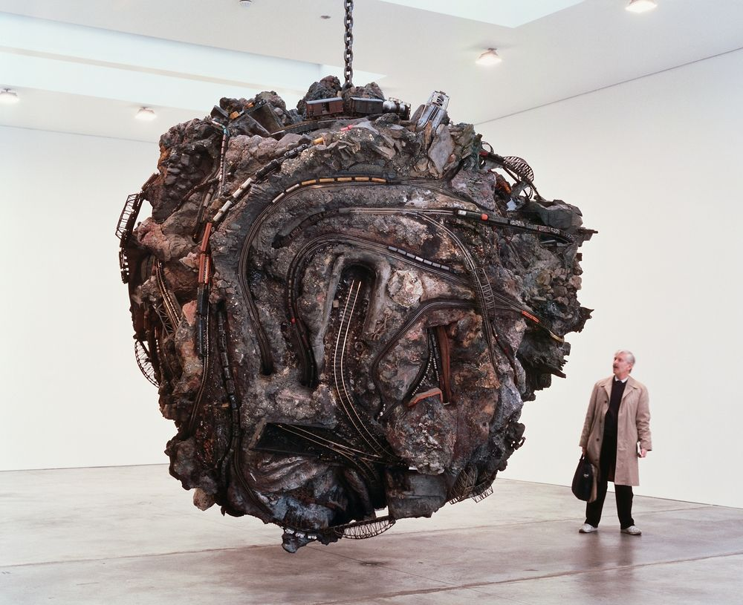
Line Quality…Continued
Continuity
Or Linear flow, can increase movement and accentuate from.
In Chris Burden’s Medusa’s Head a mad tangle of toy train tracks flows around and though the mass of stone, plywood, and cement.
Representing the snakes that crowned the head of a mythical monster, these writhing lines accentuate the spherical mass and gives us a fresh interpretation of an ancient Greek myth.
Chris Burden, Medusa’s Head. 1989-92

Slide 8
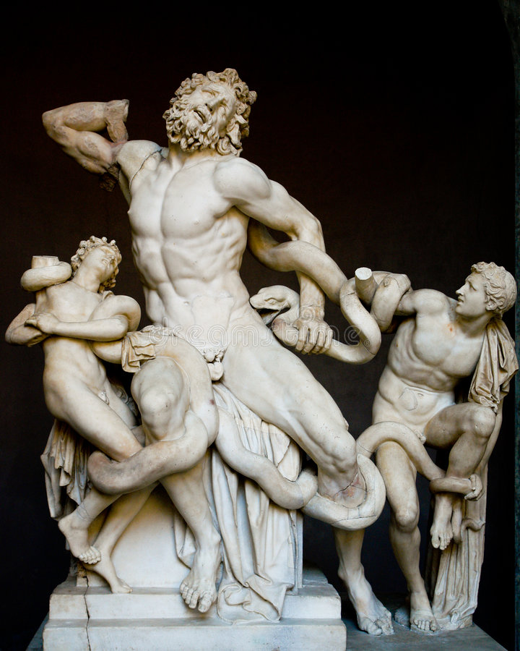
Actual Line
It actually exists in real space
Through their physical appearance actual lines can connect, define, or divide design.
Laocoon and His Two Sons depicts a scene from the Trojan War. When the Greeks offered a large hollow wooden horse to the Trojans, Laocoon warns against accepting the gift. The Greek goddess Athena then send two serpents to attack and kill the seer, there for gaining entry into Troy for the soldiers hiding in the horse.
The writhing serpent compositionally connects the terrified men while adding emotional intensity to this depiction of Athena’s wrath.
Laocoon and His Two Sons. Marble

Slide 9
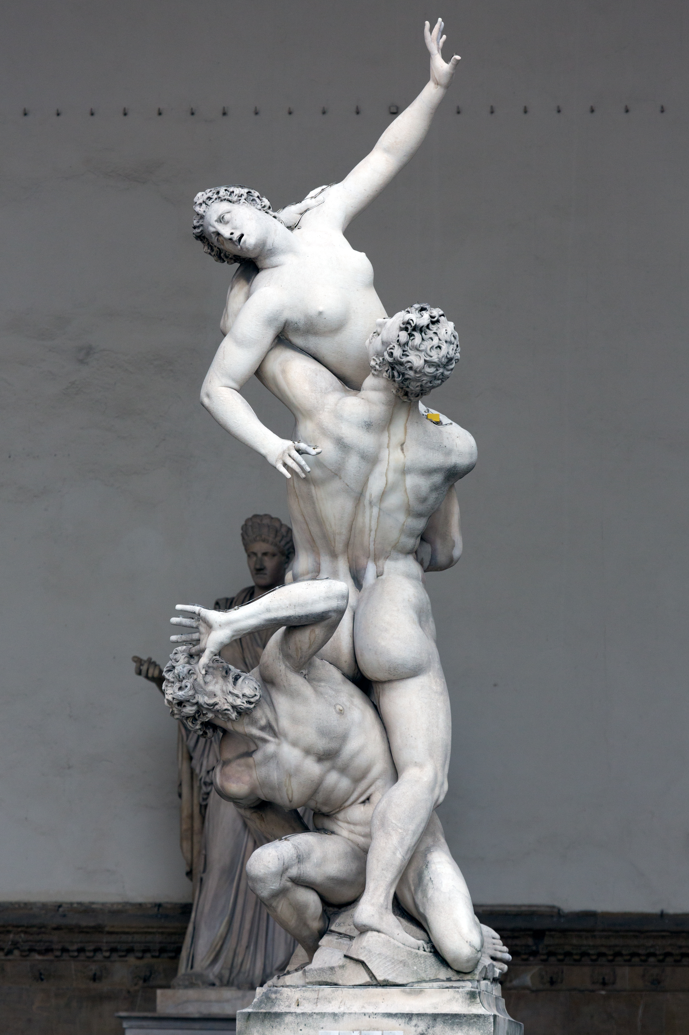
Implied Lines
Create though mental rather than physical connection.
In the Rape of the Sabine Women Giovanni da Bologna relies on a series of implied lines for its impact.
Starting at the bottom and exploding upwards, the repeated diagonal lines create a visual vortex as powerful as a tornado. At the bottom is the husband of the captured women. In the center, a standing Roman soldier is intent on stealing a wife for himself. The agitated movement culminates at the top with the embattled women’s extended arm.
Giovanni da Bologna. The Rape of the Sabine Women. 1583

Slide 10
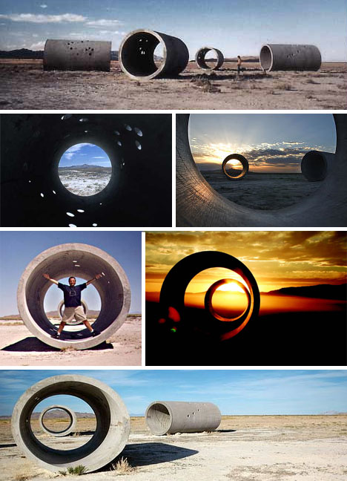
Sight Lines
Activates Nancy Holt’s Sun Tunnels.
At first glance, the four 22-tonconcrete tunnels seem static.
Upon entering each tunnel, the viewer discovers a series of holes that duplicate the stars size and positions of four major constalations.
The light pouring in through the holes shifts as the sun rises and travels across the sky. During winter solstices, the sculpture further transforms as the circular tunnels alignment frames light from the rising and setting sun.
Like a telescope, the massive cylinders are more important for the vision that they create than objects in themselves.
Nancy Holt, Sun Tunnels, 1973-76

Slide 11
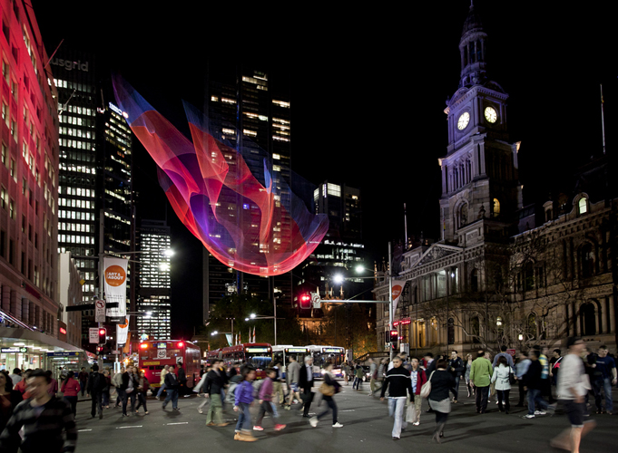
Linear Networks
Janet Echleman’s Tsunami was created using thousands of polyester fiber threads.
Suspended above a busy city street, this artwork continually shifts shape, like an undulating jellyfish.
While single lines can bring a simple eloquence to a design, multiple lines can be used to create strong, complex, and versatile forms.
Janet Echelman, Tsunami, 2011

Slide 12
Key Questions on Line
Vertical, horizontal, diagonal, and curving lines all have a unique strength. What can each type contribute to your design? Explain.
What can line continuity or discontinuity contribute to your composition? Explain.
What happens when you dramatically increase or decrease the number of lines? Explain.
Can intersecting lines strengthen your design, both structurally and compositionally? How?

Slide 13
References
Mary Stewart, lauching the imagination 2012, New York,NY McGraw-Hill Education.

