Slide 1
Funky Houses

Slide 2
Project description
Students will create Funky Slab houses. They will use found objects to roll out on their slabs to create interesting textures, then they will cut out their slabs to create a leaning, crooked, or slumping house, thinking about lines to help create a sensation or feeling of stability, movement, height, ext. They will allow their slabs to get to leather hard and then use scratching and slipping to attach them together to create the house form. Students will then add details such as windows, doors, chimneys, steps and stoops to give the house a unique look and create points of Emphasis. Students will have the option to use underglaze on some or all the components of their houses and details. Pieces will then be fired. The pieces will then need to be glazed using color or colors that best work with the piece aesthetically. Pieces will be fired and when completed turned in for a grade.

Slide 3
Requirements
Projects Must:
Be a funky house constructed by slab techniques
Use found object textures for the walls of the house
Have attachments, piecing, and carving in the design to create emphasis
Use underglaze and glaze to create contrast and color on the piece and in the details

Slide 4
Elements and Principles to Focus on
Elements
Principles
Line-The quality, orientation, direction, continuity, and unity of your edges and lines.
Texture-is the surface quality that can be seen and felt. Textures can be rough or
Unity-All elements of the piece work to gether harmoniously to create a well thought our composition.

Slide 5
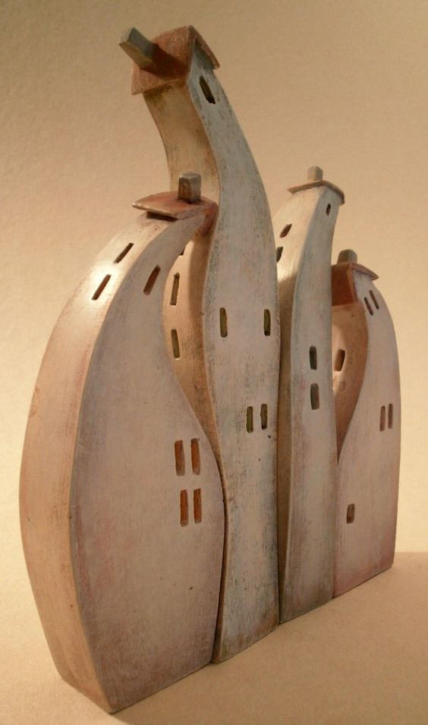
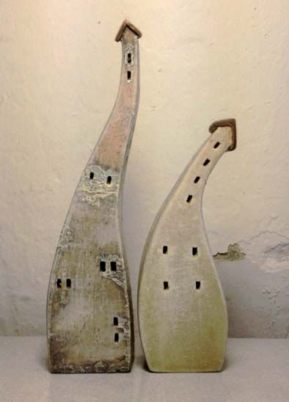

Slide 6
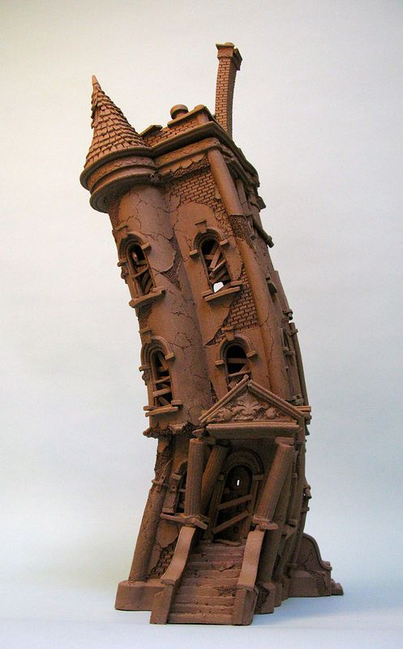
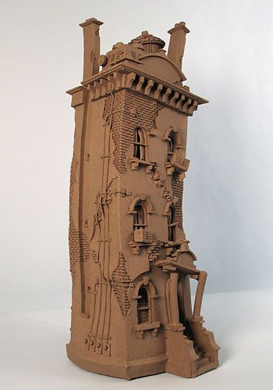

Slide 7
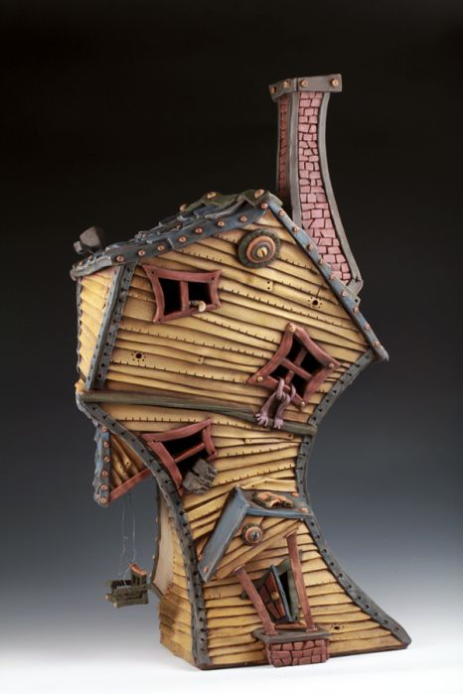
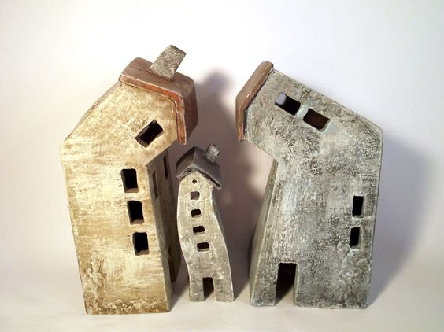

Slide 8
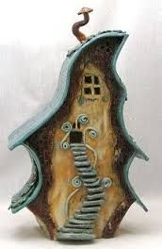
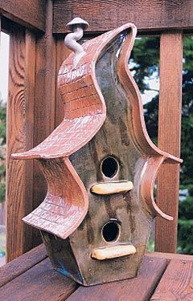

Slide 9
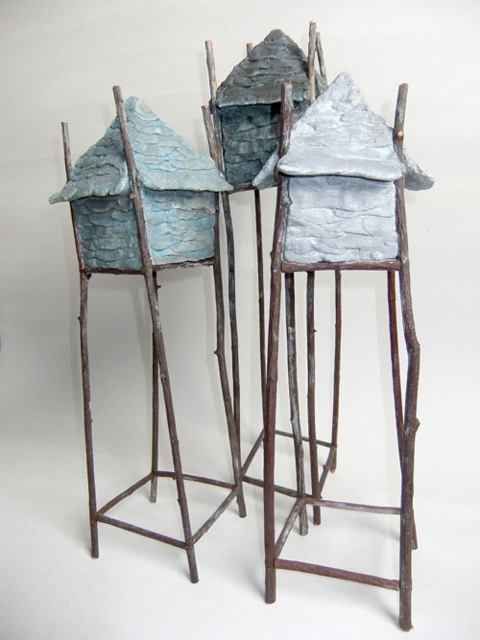
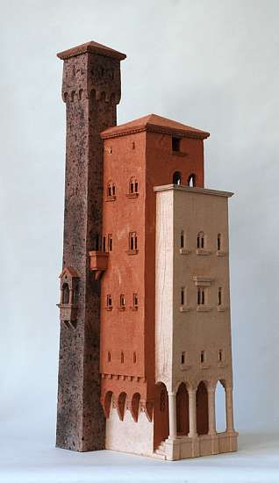

Slide 10
Sketchbook Assignment
You need to create three separate sketches of three different ideas
Sketches need to be two views in color, one idea per page, of the complete piece, and drawn with intent
Once sketches are drawn you need to pair up with one other person and discuss your sketches to get feed back one which one is the best, most unified, harmonious composition.
Your partner needs to write below the piece they think has the best composition one or more sentences describing why the have selected this piece out of the three ideas.

